Slide 1
DeFi Insurance
Xunan

Slide 2
Outline
Overview
Nexus Mutual
Cover Protocol
Comparison
Others

Slide 3
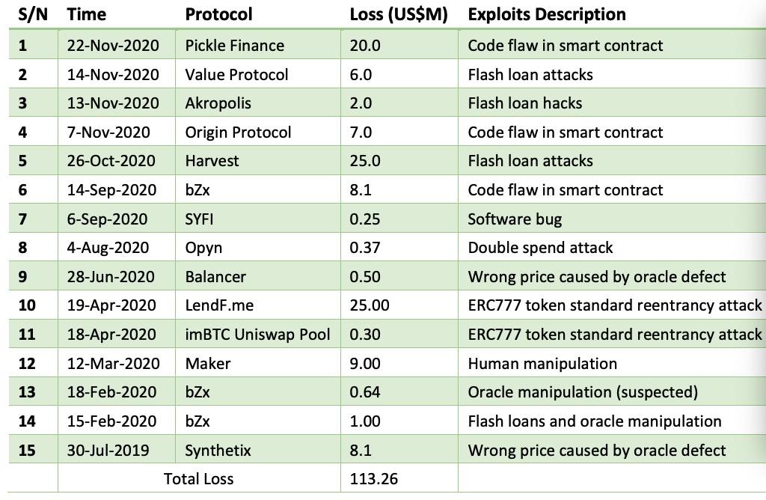

Slide 4
Overview
Current DeFi insurance includes:
Common Capital Pool: Nexus Mutual
Prediction Market: Cover Protocol
Financial Derivative: Opyn
Successful claimed event:
bzx flash loan attack (2.15, 2.18):
Total loss $1.6M
Nexus Mutual claimed 32600 DAI + 4 ETH
Pickle contract attack (11.22):
Total loss $20M
Cover protocol claimed $282,035

Slide 5

Nexus Mutual
A peer-to-peer discretionary mutual on the Ethereum blockchain
Launch Time | 2019.05
Cover Type | Smart Contract
Token | NXM
TVL | $96.93M
KYC | ✅
Covered Events:
Protection against material loss of value resulting from "unintended uses" of smart contact code.
Uncovered Events:
Loss of private key, external environment change, ...
https://nexusmutual.io/

Slide 6
Major Role
User:
People who wants to buy coverage, needs to pay premium
Risk assessor:
People who decides the risk of a contract and wants to provide coverage, earns premium
Claim assessor:
People who decides a claim is approved or not, earns fee
Governance:
CVC member who processes the proposal submitted by the members of the mutual

Slide 7
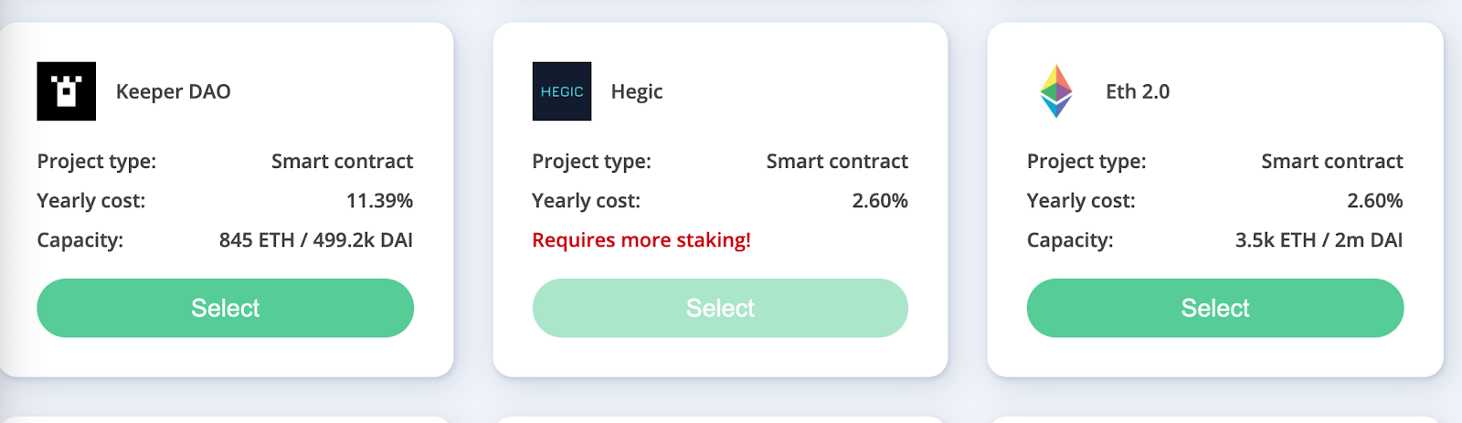
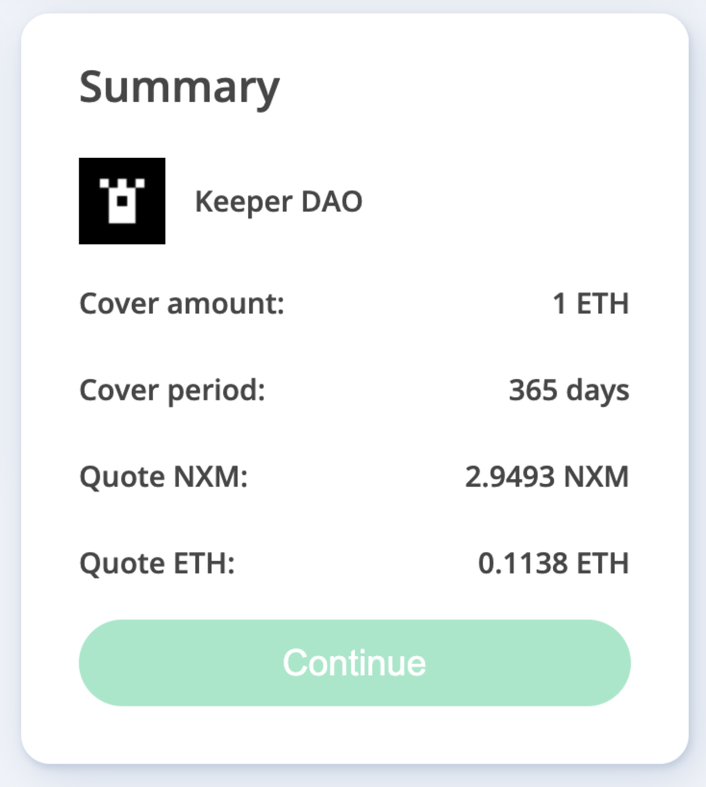
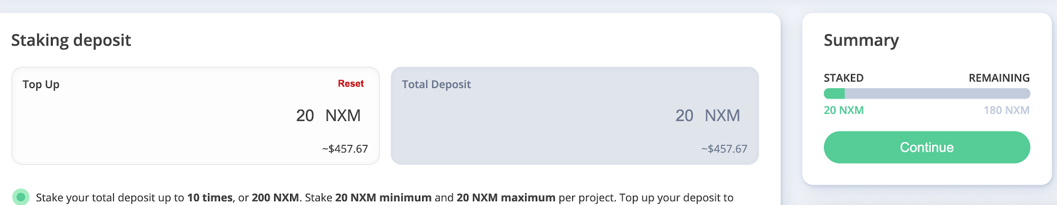
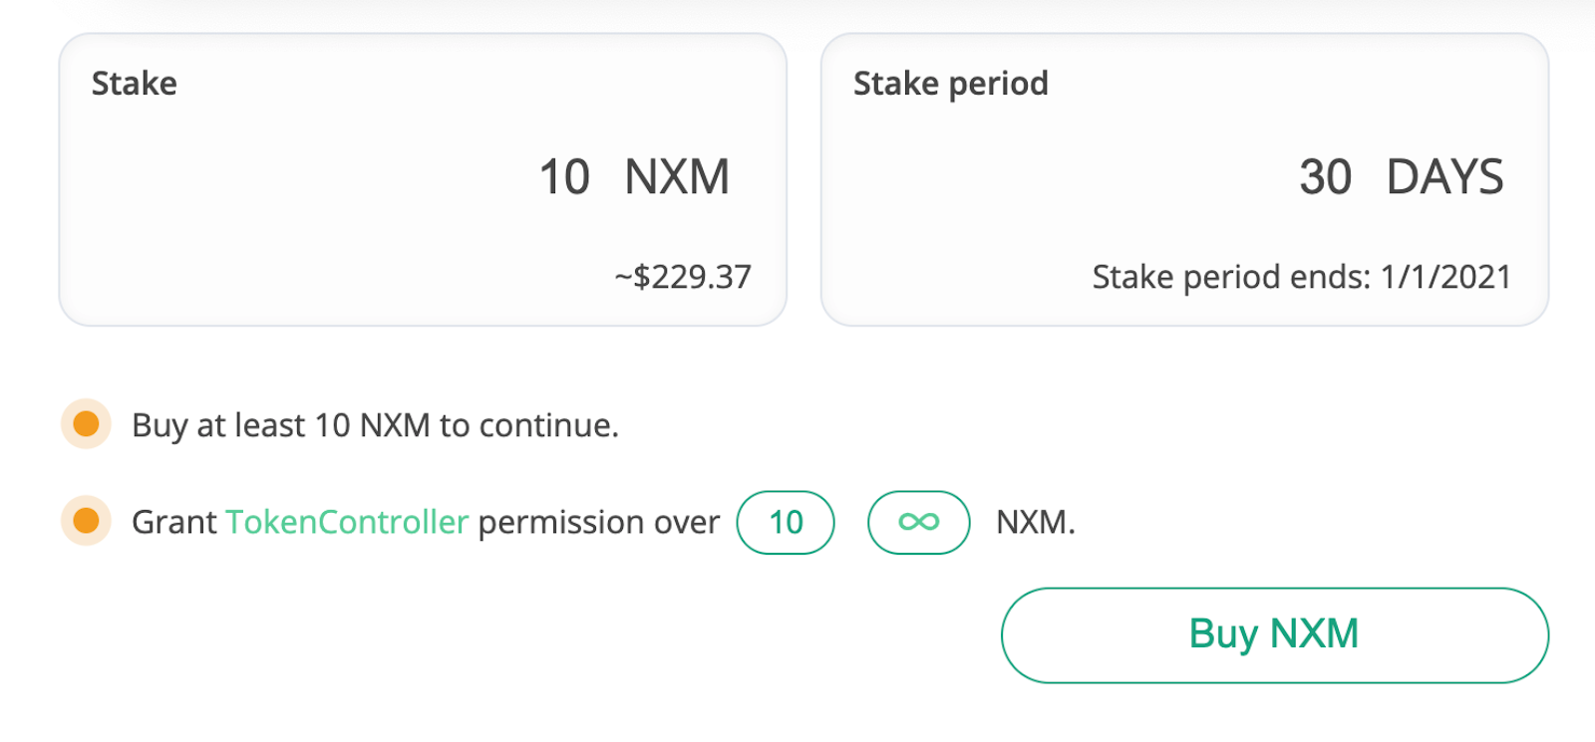
Buy Cover
Risk Assessor (10x leverage)
Get Quote
Claim Assessor

Slide 8
Risk Cost
Risk_Cost is a factor in calculating premium, which reflects the value staked in a contract
net_staked_NXM: Total stake amount of a specific contract
Low_risk_cost_limit: Amount of stake required to reach the low risk cost (50,000 NXM)
Risk_cost range: [2%, 100%]
The more risk assessors staked, the lower risk the contract has

Slide 9
Cover Price
Cover_Price is the premium for a contract, which is determined by risk_cost, cover_period, cover_amount
Surplus_margin: 0.3
The higher risk_cost, the higher cover_price
The longer cover_period, the higher cover_price
The larger cover_amount, the higher cover_price

Slide 10
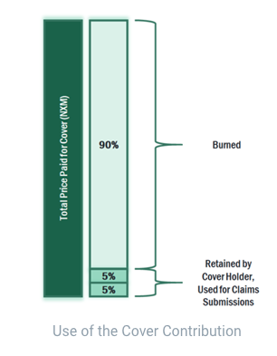
Buy Cover
Select the cover you want to buy
Get quote
Purchase cover
If you buy cover using DAI / ETH, the system will exchange it to NXM, then buy cover.
90% of the NXM used to purchase cover are then used (“burned”). The other 10% remain with the member and are either used as a deposit when submitting claims or are returned to the cover purchaser if no claim is made.

Slide 11
Risk Assessor (RA)
RA is a member staking NXM tokens against particular risks they think are secure.
Parameter | Value
Self-Judgment | ✅
Stake Amount | 10x
Unstake Lock-time | 90 Days
Fee Pool | 50% of the Cover Price
Punishment | Claim Amount

Slide 12
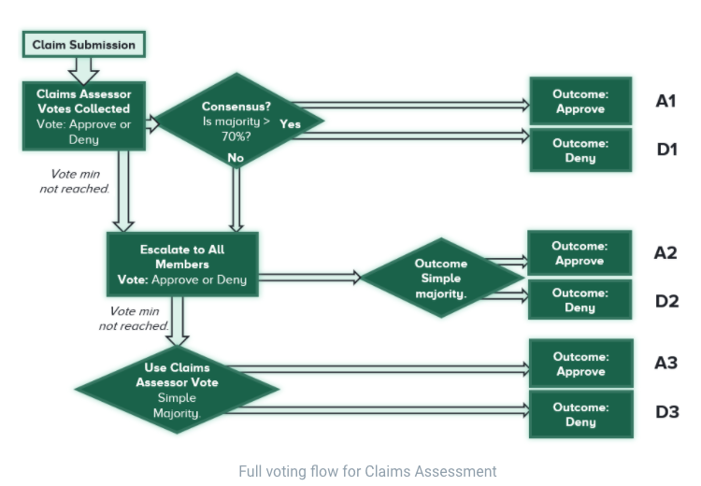
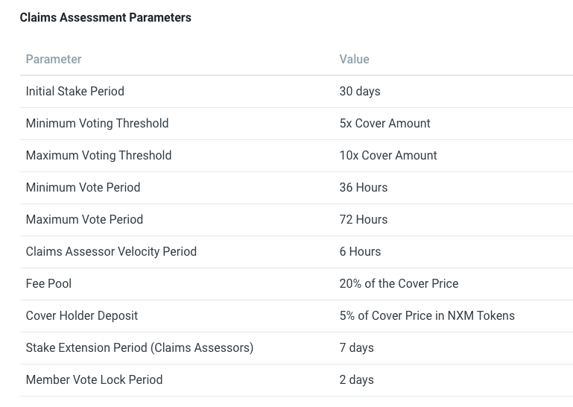
Claim Assessor (CA)
CA is a member staking NXM tokens to participate claim voting process.

Slide 13
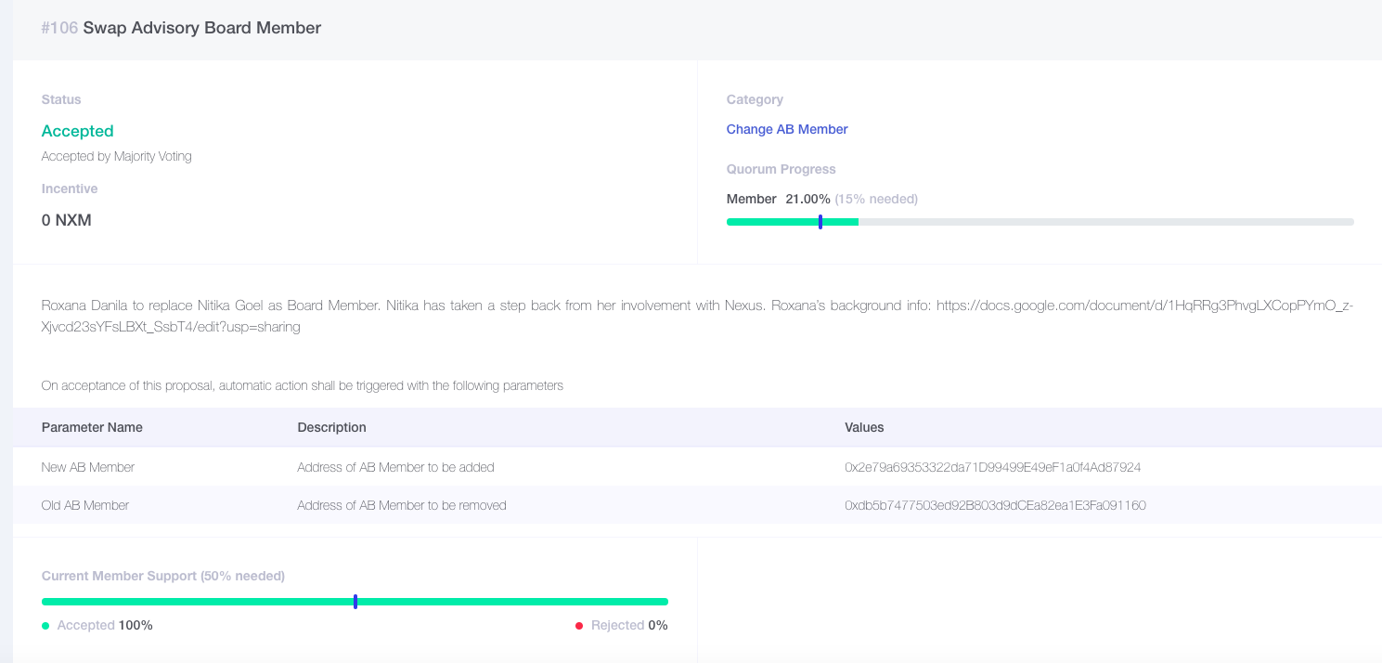
Governance

Slide 14
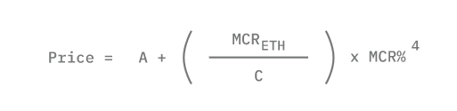
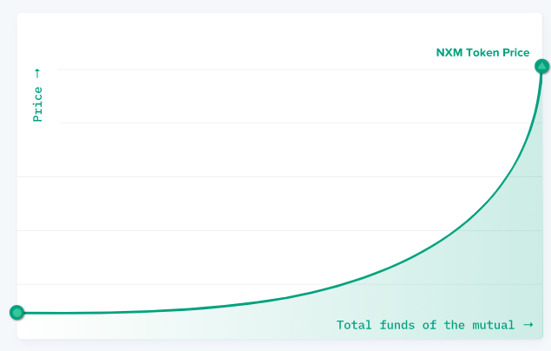
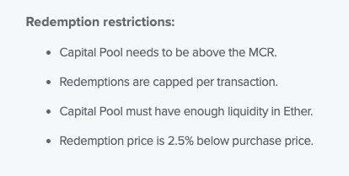
NXM
NXM token represents membership rights. Tokens can be used to purchase cover as well as participate in claims assessment, risk assessment and governance.
Continus Token model: Bonding curve
MCR: minimum capital requirement
MCR% = Total funds of the mutual / MCR
If mutual has adequate funds, price up
If funds are low, price down
MCR

Slide 15

Cover Protocol
A peer-to-peer coverage market with Fungible Tokens
Launch Time | 2020.11
Cover Type | Smart Contract
Native Token | COVER
Fungible Token | CLAIM, NOCLAIM
TVL | $10.52M
KYC | ❌
Covered Events:
Smart contract suffers hack, bug or economic manipulation attack
Uncovered Events:
Loss of private key, external environment change, ...
https://www.coverprotocol.com/

Slide 16
Major Role
Market Maker
People who hold both CLAIM and NOCLAIM tokens and provide liquidity for both
Coverage Provider
People who hold and provide liquidity for only NOCLAIM tokens
Coverage Seeker
People who hold and provide liquidity for only CLAIM tokens
Claim Validity Committee
People who decides a claim is approved or not

Slide 17
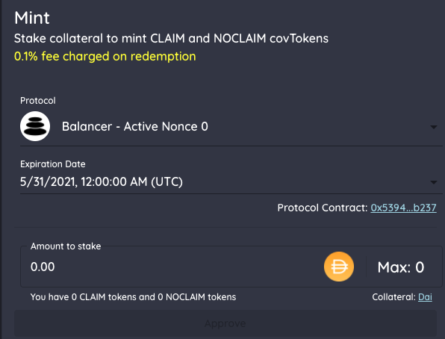
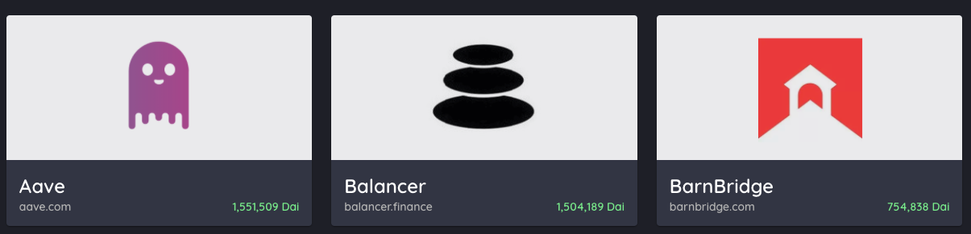
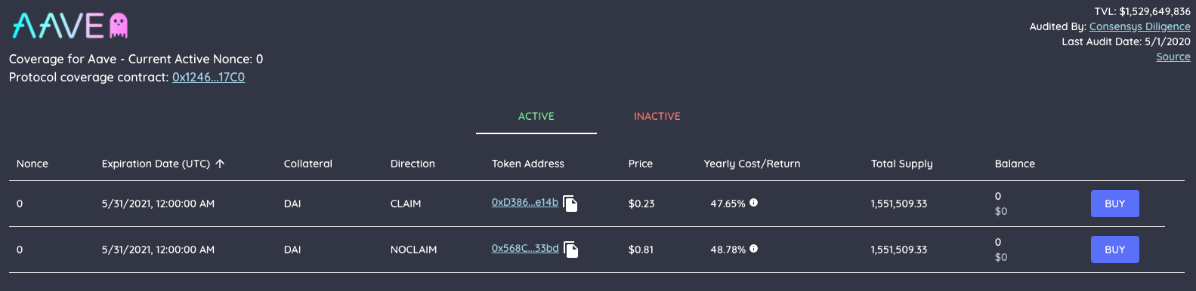
Get Fungible Token
1 DAI: 1 claim, 1 noclaim
Buy Cover

Slide 18
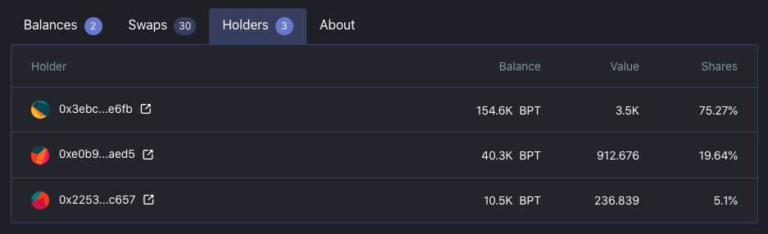
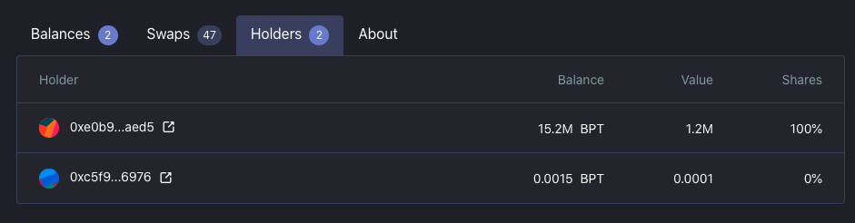
CLAIM pool
NOCLAIM pool

Slide 19
Fungible Token
Fungible tokens are created when deposits collateral.
1 collateral = 1 CLAIM + 1 NOCLAIM
Claim event: 1 CLAIM token = 1 collateral, 1 NOCLAIM token = 0
Expiration claim event: 1 CLAIM token = 0, 1 NOCLAIM token = 1 collateral
Ticker symbol:
COVER_{Protocol}_{Expiration Date}_{Collateral Currency}_{Nonce}_{Direction}
For example: COVER_CURVE_2020_12_31_DAI_0_CLAIM

Slide 20
Market Maker (MM)
When a new cover is added, Cover Protocol will create:
Balancer pool with 98% CLAIM tokens and 2% collateral
Balancer pool with 98% NOCLAIM tokens and 2% collateral
People deposits collateral, receives both tokens, then provide liquidity
Benefit: Earn swap fee in balancer, Participate COVER yield farming
Risk: Impermanent loss from providing liquidity

Slide 21
Coverage Provider (CP)
People deposits collateral, receive both tokens, sells CLAIM token, then hold and provide liquidity for only NOCLAIM token
(People can also directly buy NOCLAIM token if there is arbitrage opportunities)
Benefit: Earn premium by selling CLAIM token, Earn swap fee in balancer,
Participate COVER yield farming
Risk: Loses collateral from paying claim, Impermanent loss from providing liquidity

Slide 22
Coverage Seeker (CS)
People deposits collateral, receive both tokens, sells NOCLAIM token, then hold and provide liquidity for only CLAIM token
(People can also directly buy CLAIM token if there is arbitrage opportunities)
Benefit: Be protected in cover period, Earn swap fee in balancer,
Participate COVER yield farming
Risk: Lose premium, Impermanent loss from providing liquidity

Slide 23
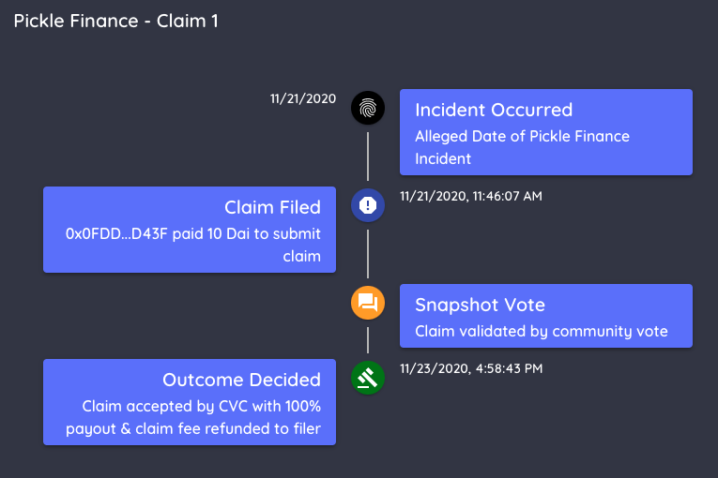
Claim Validity Committer (CVC)
People can submit a voting claim or forced claim
CVC will review the claim and make a decision whether the claim is accepted or rejected. If more than 50% of the CVC member agree, they also needs to decide payout percentage (up to 100%)

Slide 24
Comparison
 | Nexus Mutual | Cover Protocol
Pros | Simple Model Decentralization decides claim User no needs to hold token | No KYC High flexibility Anytime redeem
Cons | KYC Low flexibility Restrict redeem | Complex model Centralization decides claim User needs to hold token

Slide 25
Others
Nsure: Open Insurance platform for open finance
Alpha release
No KYC
Cover price is decided by both provider and buyer
One round vote

